Slide 1
ENSE 496ab Milestone 3
MudsnakeFC
Zain Chowdhary, Connor Meredith, Demitri Kourles, Xiaojie Chen, Jinpeng Chen, Shuaihao Zhao
Oct. 25, 2018

Slide 2
Team introductions
Team members
Zain Chowdhary, Connor Meredith, Dimitri Kourles, Jinpeng Chen, Xiaojie Chen, Shuaihao Zhao
Team name
Mudsnake FC

Slide 3
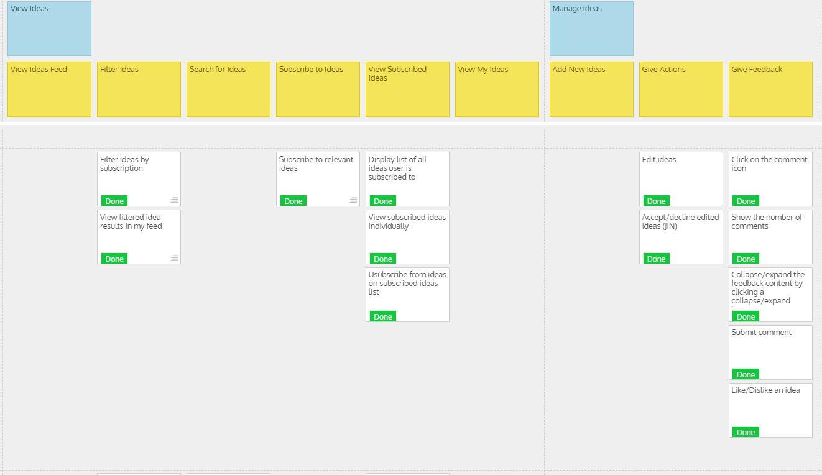
USM review (release 2)

Slide 4
USM review (release 2)
What was envisioned?
Implement the subscription feature. This included the ability for users to subscribe to or unsubscribe from ideas.
Allow users the ability to filter ideas that they are subscribed too.
The rest of the actions were to be implemented, including edit and approve/decline.
Add the ability to comment and like ideas.
Did things stay the same or change?
We did not deviate from our USM.

Slide 5
USM review (release 2)
Rationalize your MVP
The first MVP was built to allow users basic functionalities within our application such as log in and out, submitting ideas, and viewing an idea feed. Our second release aims to extend upon these functions while also implementing some of the smaller details. This involved the implementation of the subscription, filter, and feedback functionalities, as well as including the rest of the actions that can be performed on an idea based on its status.
Discuss time management
Generally we meet after class on Tuesday’s and/or Thursday’s. These meetings are used to delegate tasks for the milestone and help each other with any issues. Any further communication is done through group messaging.

Slide 6

MVP/Sprint-2 Demo

Slide 7
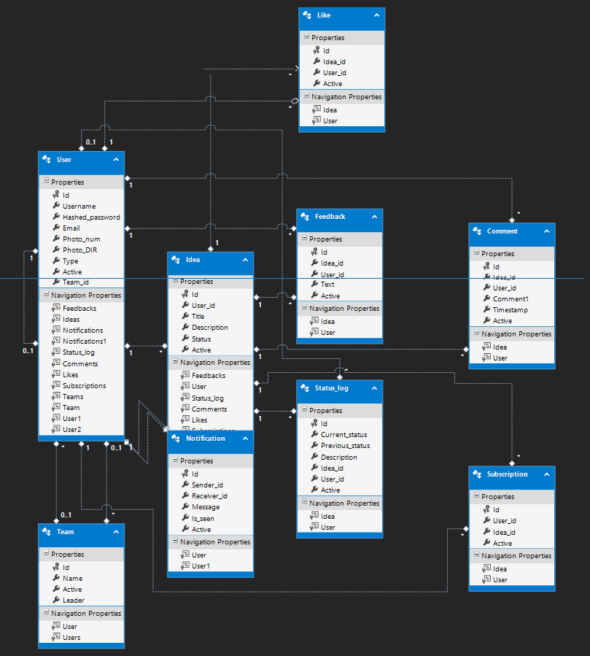
MVP/Sprint-2 Demo

Slide 8
Comments/Discussion
Successes
We achieved every goal that we set for this release. This time everybody was able to get involved in the coding aspect of it.
Barriers to success
The delegation of tasks between six people is still somewhat difficult. However, an improvement was made this milestone as everybody contributed to the code and everybody is continually getting more familiar with the technical aspect.
Was everything good, or would stuff & things have been better if…
Nothing to mention considering we achieved all of our goals for this release.

Slide 9
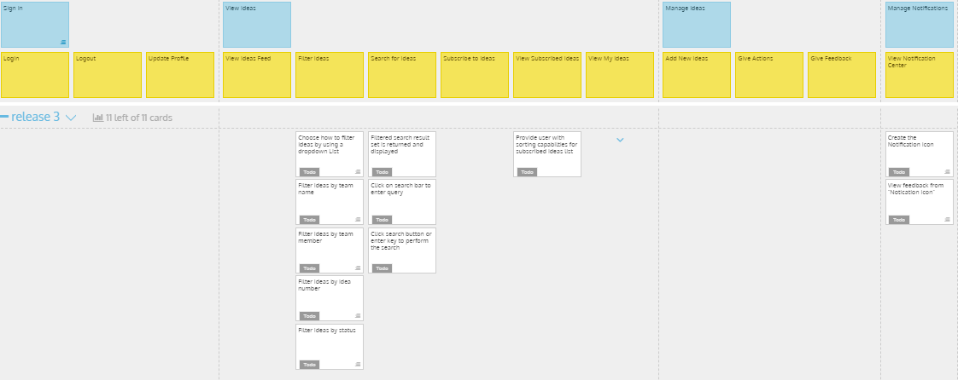
USM for MVP/Sprint-3

Slide 10
USM for MVP/Sprint-3
Address key deliverables/revisions
Add a search feature
Add the ability to filter ideas based on varying criteria
Add a sort feature
Set up the notification feature
Address and rationalize why the MVP/Sprint-3 can be considered as such
Now that we have implemented the main functions of our website, the goal of our next release is to improve the overall user experience of our application. We will achieve this by adding the convinient features mentioned above. This set of features will collectively allow the user to tailor the applications views towards themselves.

Slide 11
Group reflection
How did you feel about this milestone? What did you like about it? What did you dislike?
The fact that we had a solid base in place made this milestone easier to work through. This was also more coding heavy which we liked.
What did you learn about yourself as you collaborated and worked through this milestone?
Everybody is improving on their technical ability which allows us more freedom to work individually and integrate our code together after.
How will you use what you have learned going forward?
We should be able to produce code quicker and with less issues. This will give us more time to further improve the design of our application.
What“stuff & things" related to this milestone would you want help with?
No problems in particular

